Slide 1
Score Card Report for Departments

Slide 2
INTRODUCTION
The system focuses on the score card report for all the departments of an educational institution. It states various requirements from users' perspective and some non-functional aspects also.
The emphasis on system design is less concentrated as its major focus is on construction of a data warehouse.
The software system is used to load a sample data warehouse for a educational institution. Data from the source system are provided in A flat file extract and to be loaded to data warehouse in A relational database.
The educational institution will be using the data loaded in to data warehouse for their decision making.

Slide 3
SYSTEM REQUIREMENTS
Processor : Intel Core 2 Duo CPU
@2.93 GHz or more
Ram : 4 Gb or more
System Type : 32 bit or more
Operating System : Win7 or more

Slide 4
1. Department Dimensions 2. Student Dimensions 3. Marks Fact 4. Subject Average Aggregate 5. Subject Pass Percentage Aggregate
PROJECT REQUIREMENTS

Slide 5
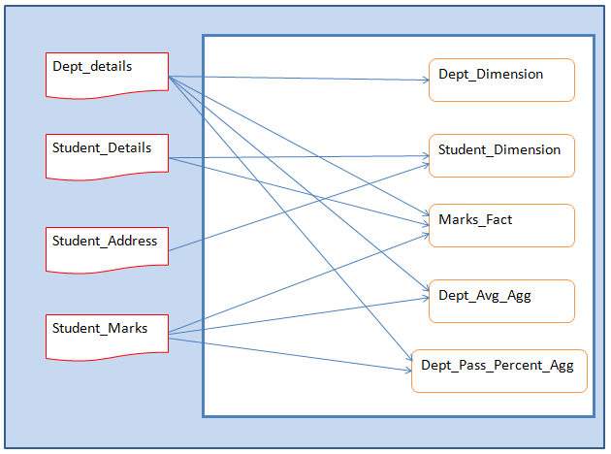
DATA FLOW DIAGRAM

Slide 6
1
Department Dimension
Files used as source is Department Details
The required output needed is to print Department Code and there respective Department Names
Expression Transformation is used to perform the desired result.

Slide 7
1
Input File
Output File

Slide 8
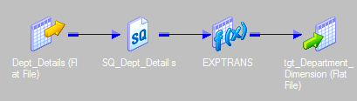
1
Mapping

Slide 9
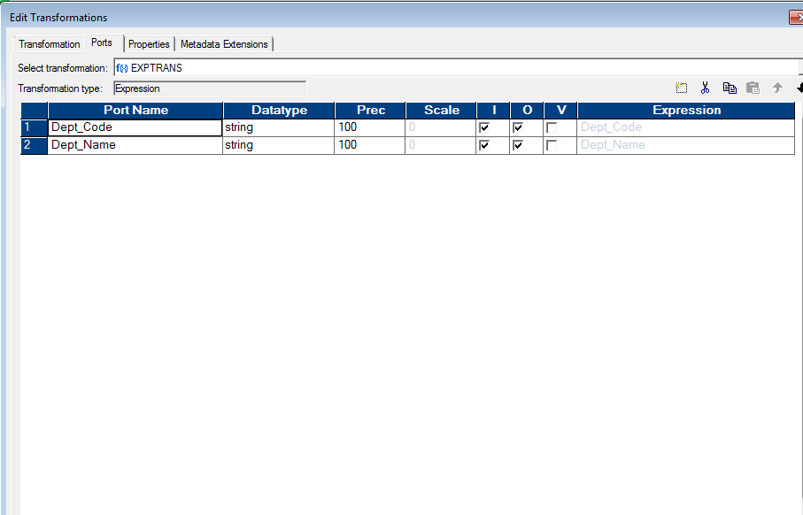
Properties & Expressions
1

Slide 10
2
Student Dimension
Files used as source are Student Details and Student Address Details.
Required output:
Checked for valid phone numbers, if found not valid replaced with NULL
Postal code column has been cleansed to remove any extra spaces and special characters
Address is printed in Upper Case
Transformations used are Joiner and expression.

Slide 11
2
Input File
Output File

Slide 12
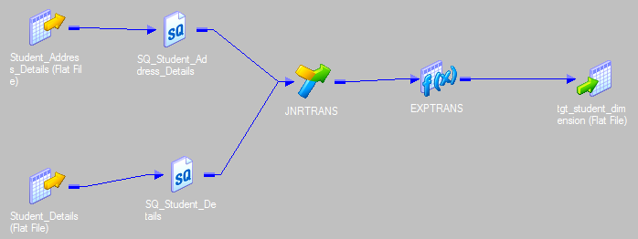
2
Mapping

Slide 13
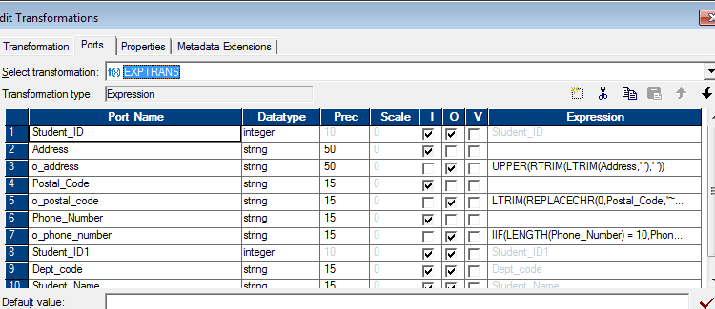
2
Properties & Expressions

Slide 14
3
Marks Fact
Files used as source are Students marks, Students details and Student Address
Sum and Average of all students has been calculated and remarks are given as ‘PASS’ or ‘FAIL’
Transformations used are Joiner, Lookup, Aggregator and expression.

Slide 15
3
Input File
Output File

Slide 16
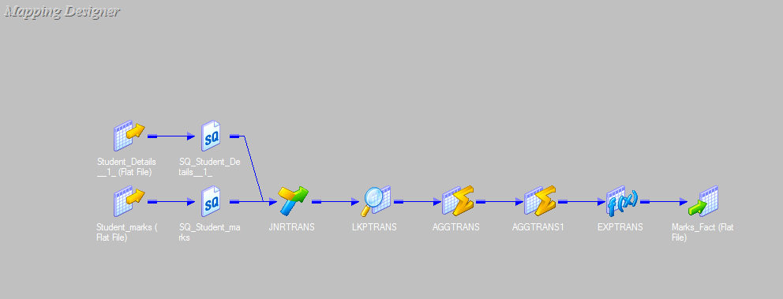
3
Mapping

Slide 17
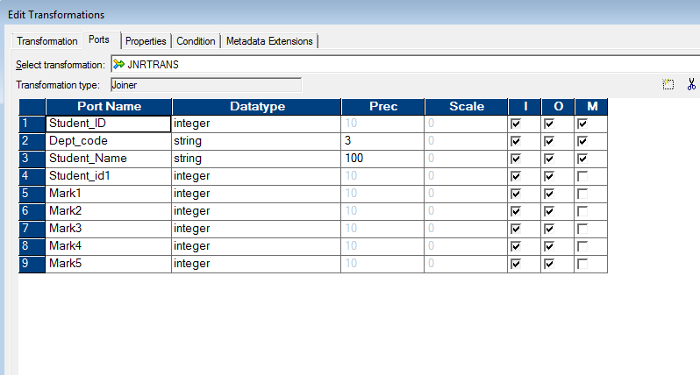
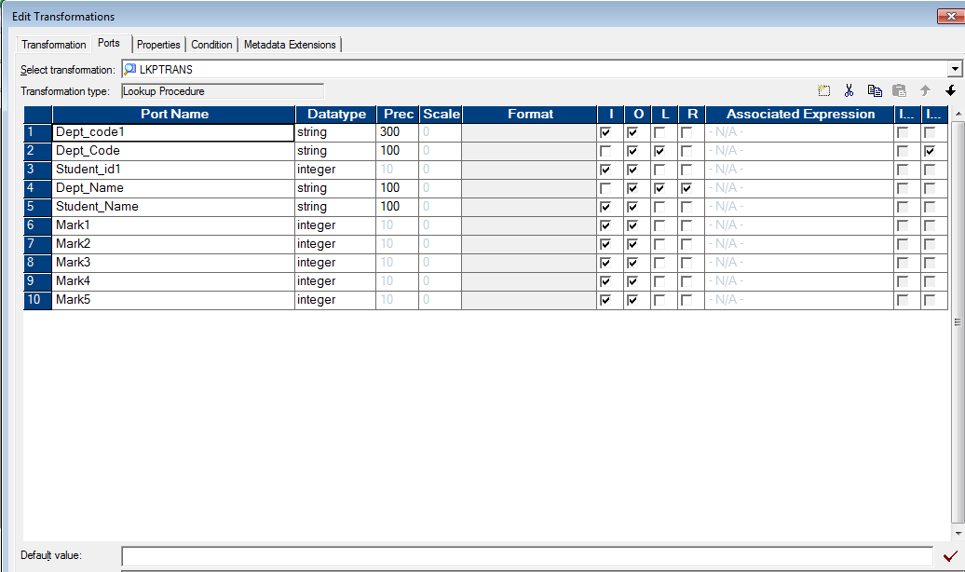
Properties & Expressions
3

Slide 18
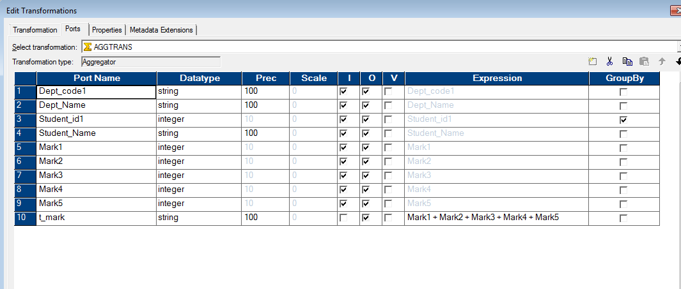
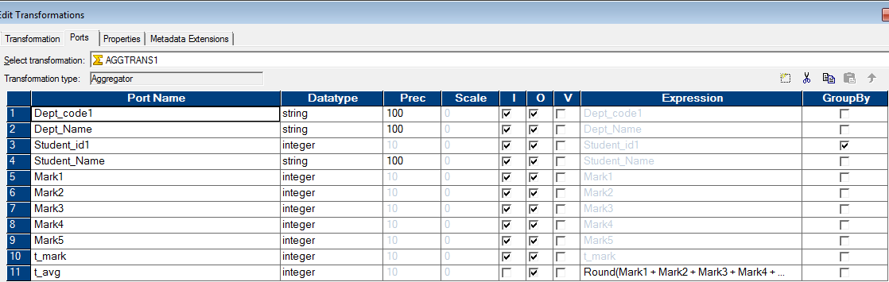
3

Slide 19
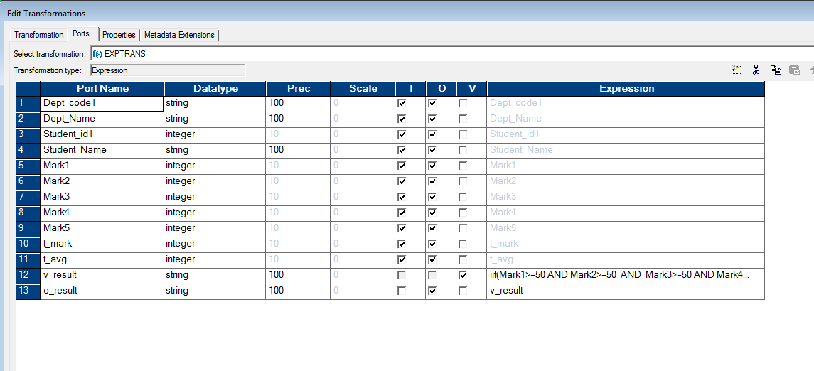
3

Slide 20
4
Subject Average Aggregate
File used as source is the output file of marks_fact_table
Average marks of students are calculated with respect to departments
Aggregator transformation is used.

Slide 21
4
Input File
Output File

Slide 22
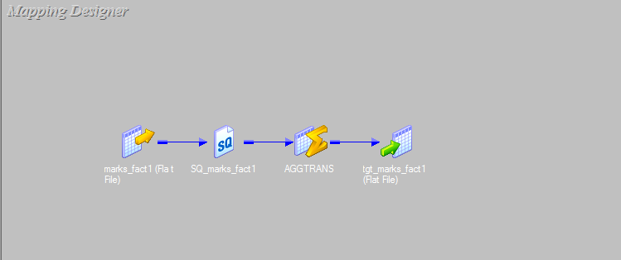
4
Mapping

Slide 23
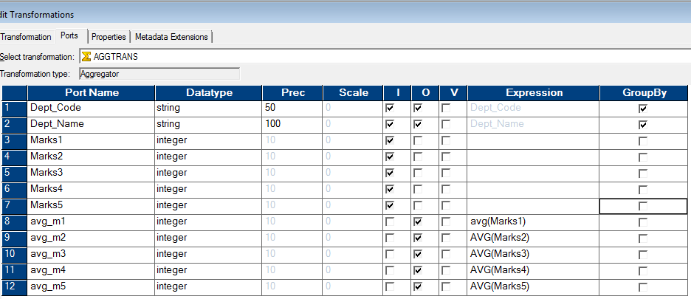
4
Properties & Expressions

Slide 24
5
Subject Pass Percentage Aggregate
File used as source is the output file of marks_fact_table
Pass percentage of all students is calculated with respect to departments
Aggregator transformation is used.

Slide 25
5
Input File
Output File

Slide 26
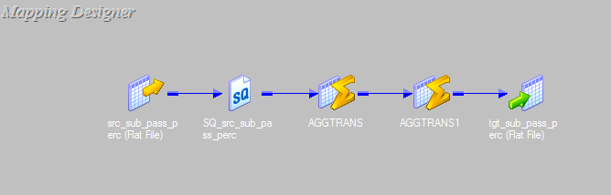
5
Mapping

Slide 27
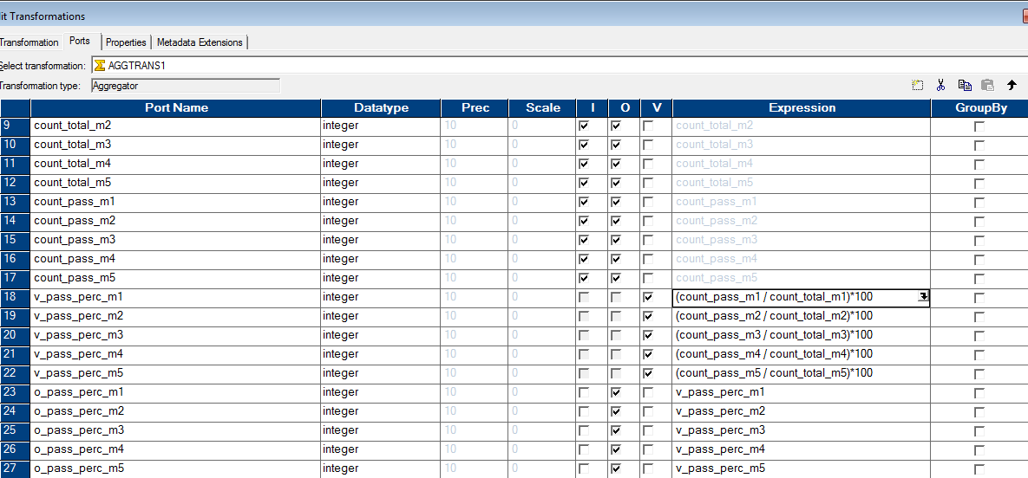
5
Properties & Expressions

Slide 28
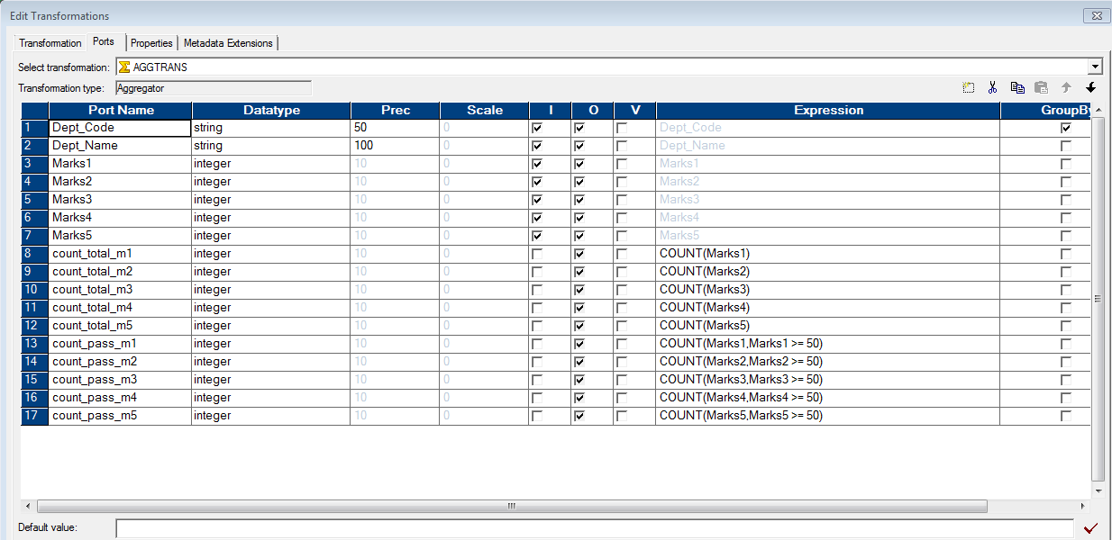
5

Slide 29
CONCLUSION
The following tasks are completed and respective screenshots are taken.
Department Dimensions
Student Dimensions
Marks Fact
Subject Average Aggregate
Subject Pass Percentage Aggregate
All the stated requirements are met with complete output and the system is completely tested.

Slide 30
REFERENCES
http://gowtham-informatica-reference.blogspot.in/2013/03/what-is-informatica.html

Slide 31
THANK YOU
Solutions Provider :
Ajay Soni

